Slide 1
What is Elliptic Curve Cryptography?
Daniel Dreibelbis
University of North Florida

Slide 2
Outline
Define the Key Exchange Problem
Define elliptic curves and their group structure
Define elliptic curves mod p
Define the Elliptic Curve Discrete Log Problem
Elliptic curves for KEP
Real life example

Slide 3
Basic Cryptography
Alice wants to send a message to Bob.
“Be sure to drink your Ovaltine.”
Eve is listening to any communication between Alice and Bob.
Goal: Encrypt the message in a way that Alice and Bob know, but Eve does not.

Slide 4
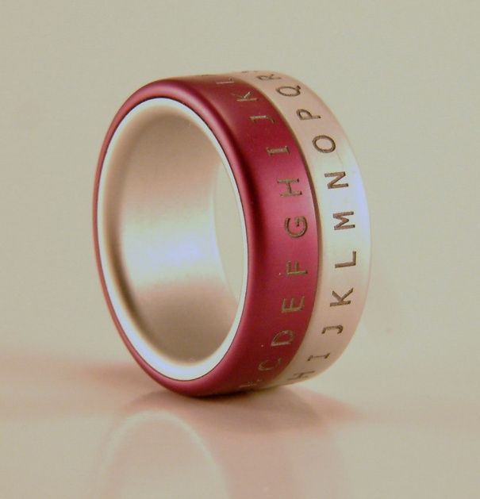
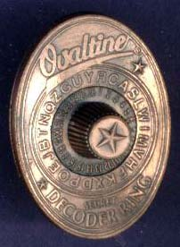
Secret Decoder Ring
Simple substitution cipher.
Each letter is replaced by a letter k letters down the alphabet.

Slide 5
Secret Decoder Ring.
Standard Caesar Code has k = 3.
“Be sure to drink your Ovaltine.” becomes “Eh vxuh wr gulqn brxu Rydowlqh.”
Bob decodes by removing k from each letter.
The number k is called the key. Our SDR has 26 different keys.

Slide 6
Real Life SDR
Our SDR has 26 different keys.
In Real Life, we use an encryption method called AES (Advanced Encryption System).
AES has 2¹²⁸ different keys
2¹²⁸ = 340,282,366,920,938,463,463,374,607,431,768,211,456
That’s 340 undecillion. That’s a whole bunch of keys.
A brute force key search is infeasible.

Slide 7
Key Exchange Problem
Eve hears everything that Alice says to Bob and Bob says to Alice.
If Alice and Bob try to agree on a key k, Eve will hear this also, and she will know the key.
KEP: How can Alice and Bob agree on a key without Eve knowing its value?

Slide 8
Diffie-Hellman’s Idea
Say that Alice, Bob, and Eve know how to multiply numbers, but they don’t know how to divide.
Alice and Bob will agree on a number b. Then Alice will secretly pick a number p_{A}, while Bob will secretly pick a number p_{B}.
Alice will compute the number q_{A} = bp_{A}, while Bob will compute the number q_{B} = bp_{B}. Alice will tell Bob the value of q_{A}, while Bob will tell Alice the value of q_{B}.
Alice will compute k = q_{B}p_{A}, and Bob will compute k = q_{A}p_{B}. This will be their key.

Slide 9
Example
Alice and Bob agree to have b = 5.
Alice picks p_{A} = 3, while Bob picks p_{B} = 2. Alice computes q_{A} = 15, and Bob computes q_{B} = 10.
Alice and Bob exchange q_{A} and q_{B}.
Alice computes k = 3*10 = 30, while Bob computer k = 2*15 = 30. They now use k = 30 with their SDR.

Slide 10
Can Eve Figure out k?
Eve knows all shared values, which are: b, q_{B}, and q_{A}.
She wants to figure out bp_{A}p_{B}. She knows b, bp_{A}, and bp_{B}.
To do this, she needs to be able to divide. But she does not know how to divide.
In Real Life, multiplication and division are replaced with math problems that are “easy” to do, but really difficult to undo.

Slide 11
Elliptic Curves
An elliptic curve is a curve of the form
y² = x³ + ax + b
where 4a³ + 27b² ≠ 0
Plus a point O at “infinity”. It is at the end
of all vertical lines.

Slide 12
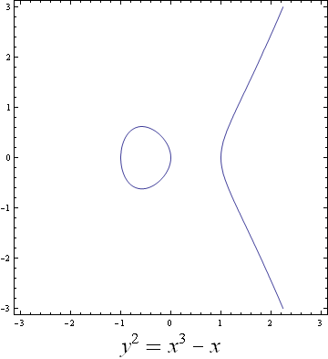
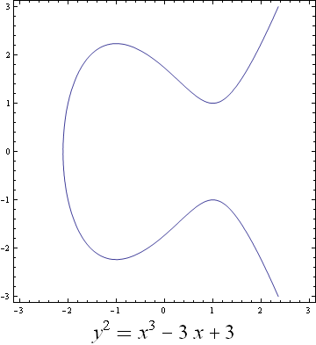
Examples

Slide 13
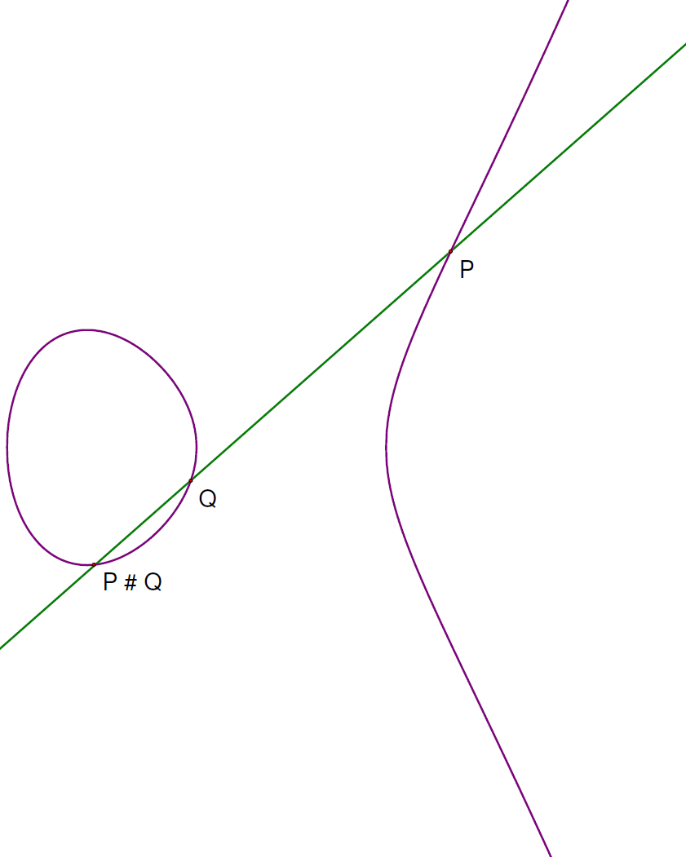
Group Structure P # Q

Slide 14
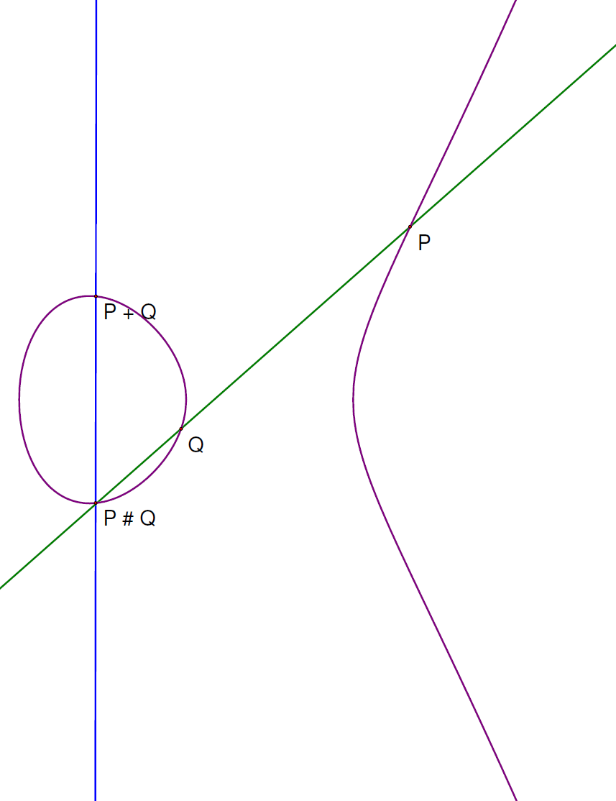
Group Structure: P + Q

Slide 15
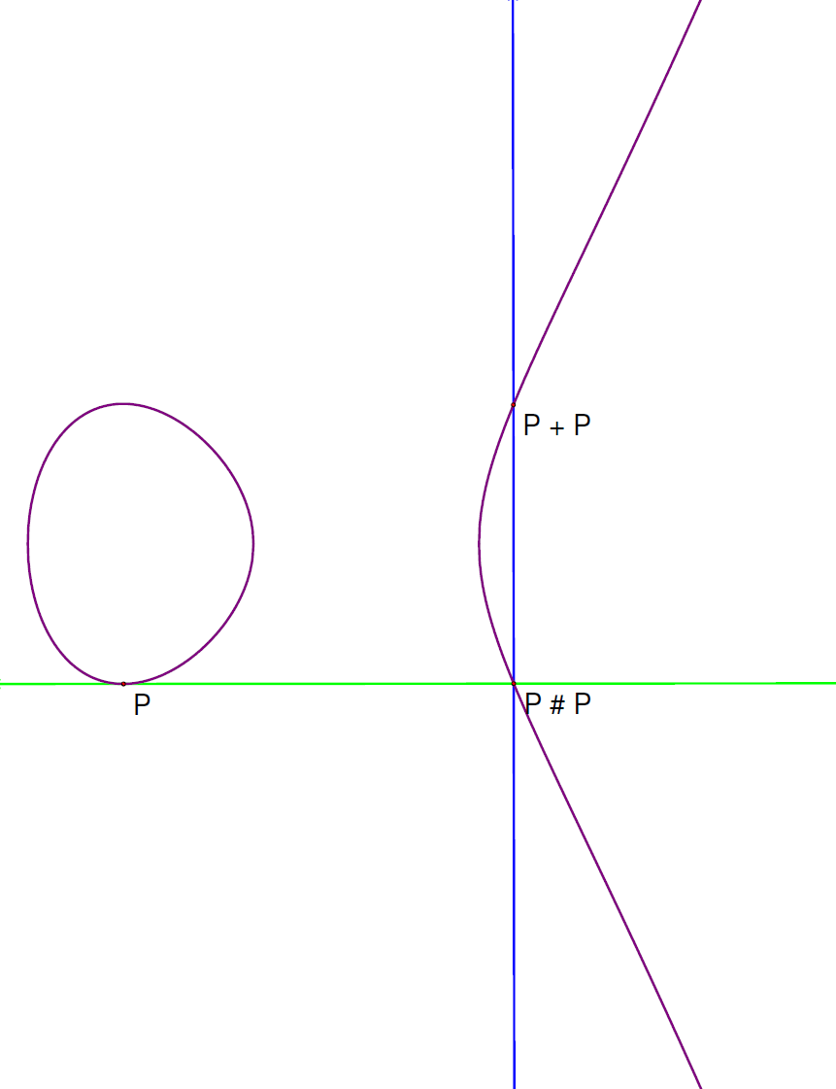
Group Structure: P + P

Slide 16
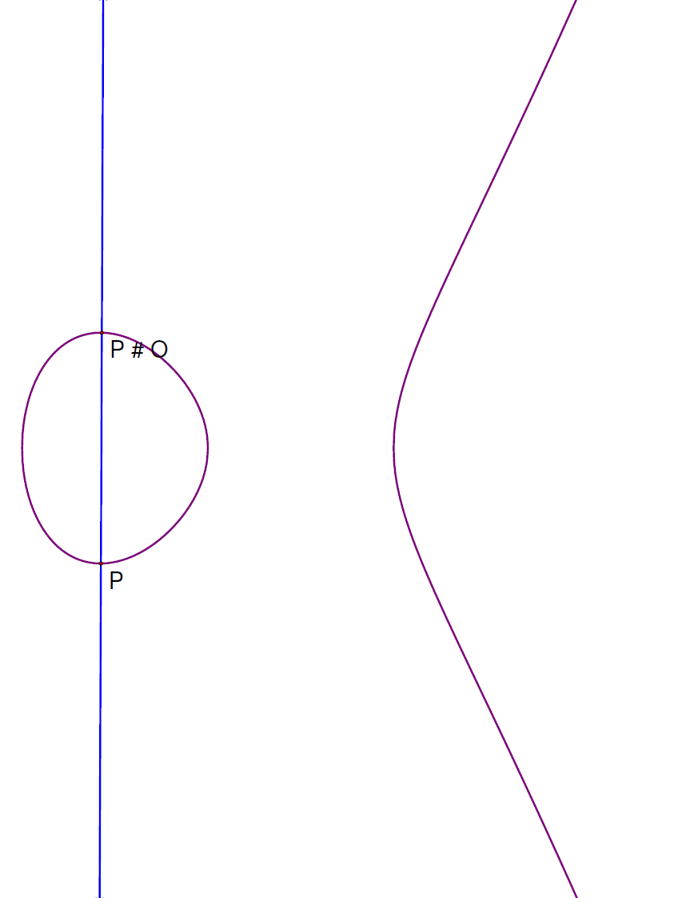
Group Structure: P + O

Slide 17
Group Structure: Recap
Using our definition of addition:
P + Q is well defined
P + Q = Q + P
P + (Q + R) = (P + Q) + R
P + O = P
-P = P # (O # O)

Slide 18
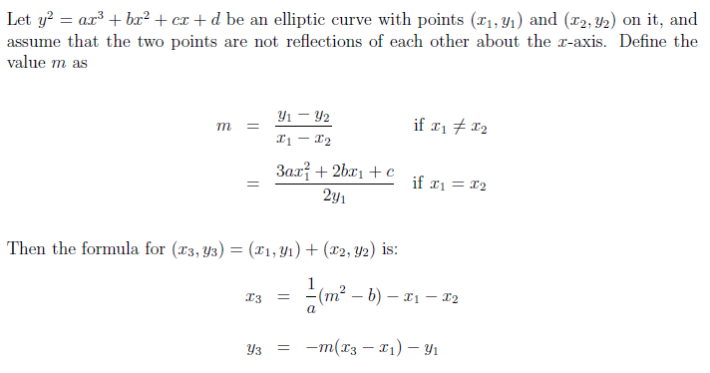
Equations for Addition

Slide 19
Changing the Field
Note that if the coefficients of the elliptic curve are in a particular field, and the coordinates of P and Q are in this field, then so is P + Q.
If the field is real numbers, then we get the pictures we’ve seen.
If the field is complex numbers, then we get modular forms.
If the field is rational numbers, then we get algebraic number theory.

Slide 20
Mod p
Define a mod b as the remainder when a is divided by b.
5 mod 3 = 2, 20 mod 7 = 6, 42 mod 7 = 0
Mod works nice with arithmetic.
If p is a prime, we use the numbers {0, 1, 2, …, p-1}, and we can add, subtract, multiply, and divide.
So we can do elliptic curves on the integers mod p.

Slide 21
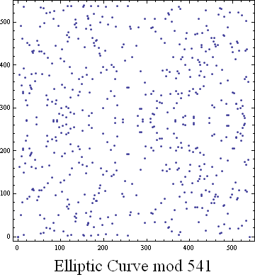
Elliptic Curve mod p

Slide 22
Defining mP
2P = P + P
3P = P + P + P
mP = P + P + … + P
No matter how big m is, there is an efficient (quick) way to calculate mP.

Slide 23
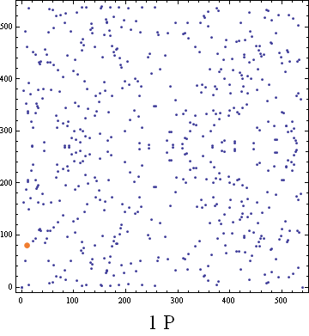
Example mod 541

Slide 24
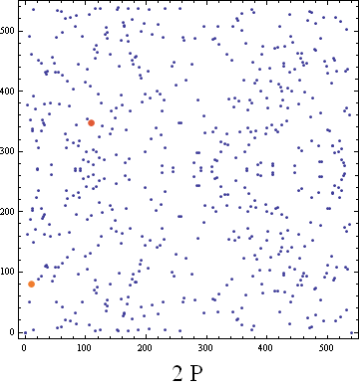
Example mod 541

Slide 25
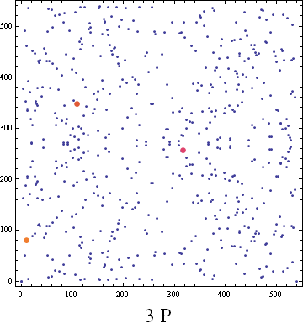
Example mod 541

Slide 26
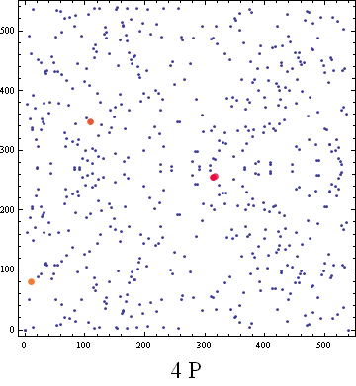
Example mod 541

Slide 27
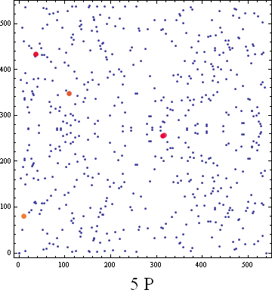
Example mod 541

Slide 28
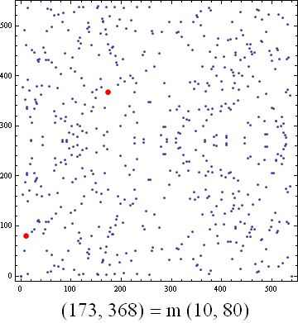
Elliptic Curve Discrete Log Problem

Slide 29
ECDLP
Begin with an elliptic curve mod p, let P be a point and let Q be a multiple of P. The ECDLP is to find the value of m such that Q = mP.
We can simply calculate 2P, 3P, 4P, etc. But if p and m are large numbers, this could take trillions of years.
Basically, we do not know of a fast way to solve ECDLP.

Slide 30
Key Exchange
Alice and Bob want to agree on a key k.
Alice and Bob agree on an elliptic curve, a large prime p (about 35 digits will do), and a point B on the curve. Eve knows the curve, the point, and the prime number.
Alice secretly picks a large number p_{A} (about 20 digits will do). Bob secretly picks a large number p_{B}. Alice computes Q_{A} = p_{A}B. Bob computes Q_{B} = p_{B}B. They exchange the points Q_{A} and Q_{B}.
Alice computes p_{A}Q_{B} = p_{A}p_{B}B. Bob computes p_{B}Q_{A} = p_{B}p_{A}B. Both use the x value of p_{A}p_{B}B for the key k.

Slide 31
Example
Let’s use y² = x³ – x with p = 541, B = (10, 80).
Alice picks p_{A} = 20. Bob picks p_{B} = 103.
Q_{A} = 20 (10, 80) = (519, 241).
Q_{B} = 103 (10, 80) = (85, 345).
When Alice gets Q_{B}, she finds 20Q_{B} = (353, 158).
When Bob gets Q_{A}, he finds 103Q_{A} = (353, 158).
They both use K = 353 for their key.

Slide 32
Is it secure?
Eve knows the elliptic curve, the prime p, the original point B, and the points Q_{A} = p_{A}B and Q_{B} = p_{B}B.
To break, Eve needs to find p_{A} or p_{A}. To get either value, Eve needs to solve the ECDLP.
No one knows how to do this in a reasonable length of time.

Slide 33
Why Use It?
Most people use Diffie-Hellman, which uses DLP instead of ECDLP.
There has been progress on solving DLP.
There has been no progress on solving ECDLP.
As far as we know, this is as difficult as a “Black-Box” log problem.

Slide 34
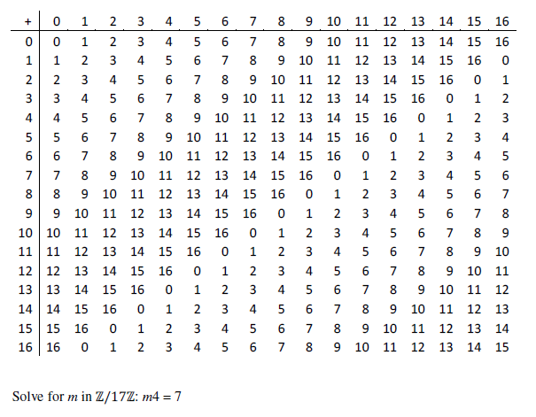
Addition Problem Mod p

Slide 35
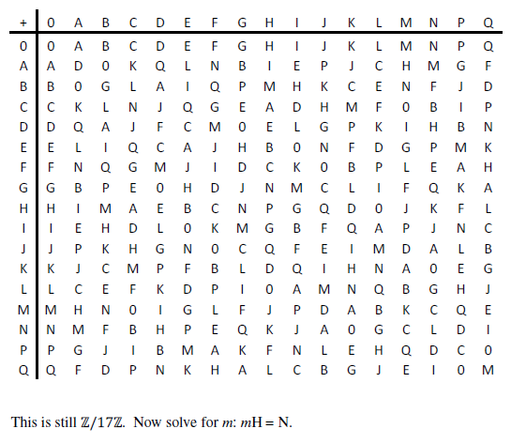
Black Box Addition Problem

Slide 36
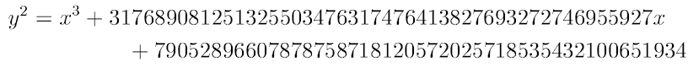
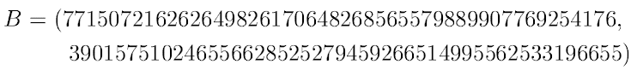
Microsoft’s DRM

Slide 37
Crypto’s Dirty Secret
Every form of public key cryptography or key exchange relies on our inability to solve a certain math problem quickly (factoring, DLP, ECDLP, SVP, etc).
It is still possible that these “hard math problems” have quick solutions. All we know is that no one has found a quick solution yet (or at least has admitted to this publicly).
Research Problem: Find a quick solution to the ECDLP (thus making ECC useless) OR prove that no quick solution exists (thus making every other form of crypto useless).

Slide 38
The End!
Thanks!
www.unf.edu/~ddreibel

